Slide 1
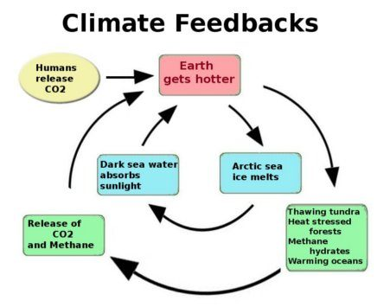
Feedbacks

Slide 2
Feedbacks
Put sulfates into the stratosphere
Earth
gets colder

Slide 3
Feedbacks
Let Earth wobble
Warmer or
colder

Slide 4
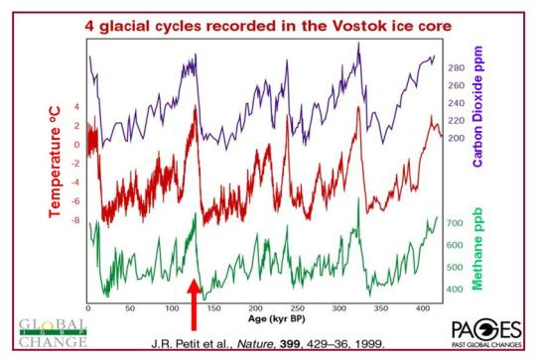
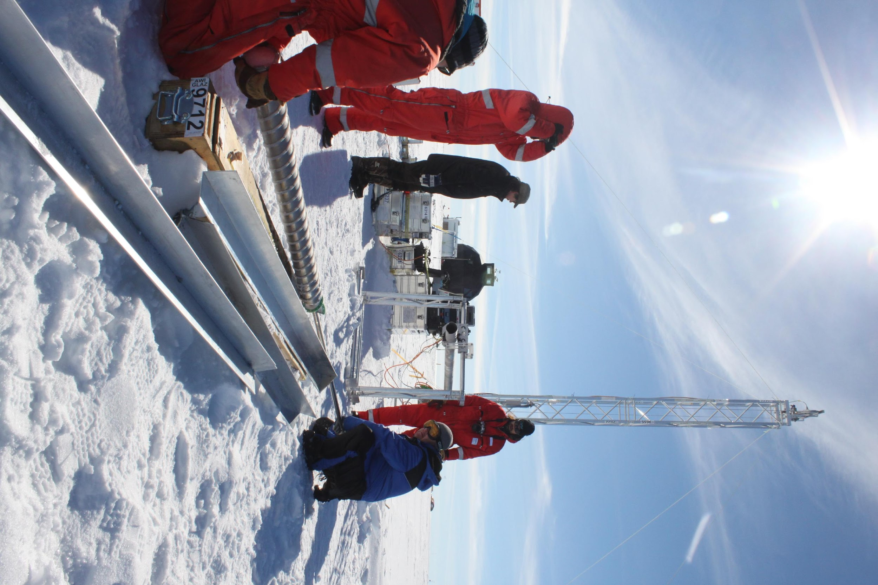
Evidence that the CO₂ and CH₄ climate feedbacks work in response to a temperature driver
Present <------- 400,000 years ago

